Slide 1
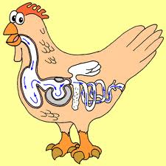
Digestive System Neosho School District

Slide 2
Why do we need food?
Food provides materials that help our bodies grow and repair tissues, and it gives us energy to do things.
Nutrients that food provides are
Fats
Proteins
Carbohydrates
Vitamins & Minerals
Water

Slide 3
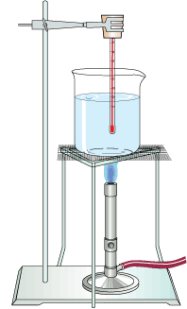
Calorie
The amount of energy required to raise the temperature of one gram of water by one degree Celsius.

Slide 4
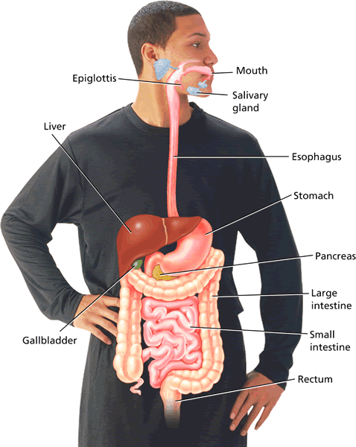
Digestive System
Breaks down food into nutrients, absorbs those nutrients, and eliminates waste.
Job is to change food into compounds your body can use for energy.

Slide 5
Mechanical Digestion
Process of breaking down food into smaller pieces by chewing, churning, tearing and mashing.

Slide 6
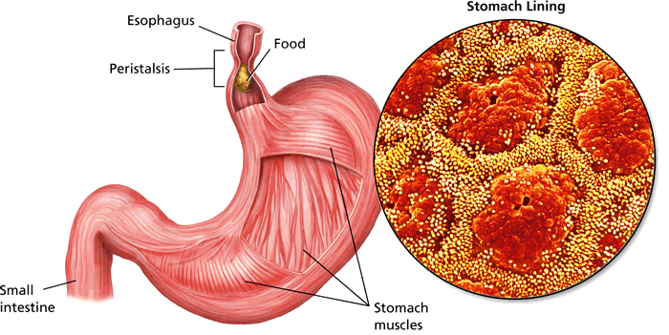
Chemical Digestion
Process that breaks large food parts into small molecules that can be taken in by cells.

Slide 7
Digestive System Organs
Mouth: food enters, saliva, tongue and teeth begin digestion
Esophagus: connects mouth to stomach
Stomach: muscles and acid continue digestion

Slide 8
Digestive System Organs
Small intestine: nutrients absorbed and passed to bloodstream
Large intestine: filled with bacteria that eat incompletely digested food
Also where absorption of water and vitamins and minerals takes place

Slide 9
Peristalsis
Muscle movement that moves food to your stomach from your mouth through the contraction and relaxation of the esophagus (smooth)muscles.

Slide 11
Saliva
Liquid produced by glands in your mouth that contains enzymes.
Enzymes- proteins in the body that help break up large food particles into molecules that the cells can use.

Slide 12
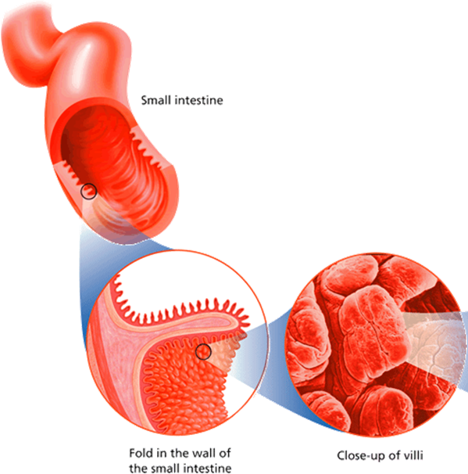
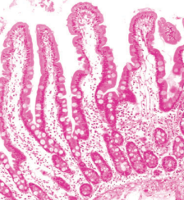
Absorption
Nutrients absorbed from food in your small intestine by villi.
Small intestine lining is connected to blood vessels that carry nutrients to your cells.

Slide 13
How does food get to your cells?
Nutrients are processed in the digestive system organs through mechanical and chemical digestion.
In the small intestine villi, nutrients pass through to the blood through vessels called capillaries.

Slide 14
How does food get to your cells?
The blood travels through the capillaries and connects to other blood vessels that travel to your individual cells.
The nutrients cross the cell membrane and enter the cell. Waste travels from the cell back into the blood stream and away.

Slide 15
Transport and Exchange
-Nutrients must be transported to your cells through the blood stream for your cells, and you, to live.
-Cells are alive and need nutrition.
-Cells create waste products that would kill them if they built up in the cell, so the bloodstream also carries away this waste.

